Slide 1
Bidirectional Training to Enhance Cancer Research Capacity in Africa
Supported by D43-CA260640

Slide 2
Motivation
The growing burden of cancer in Sub-Saharan Africa (SSA) must be addressed by African cancer researchers.
Cancer Researchers in SSA often lack
Mentorship
Collaborators
Grant writing expertise
Project management
Best practices for research rigor
Institutional Environment & Commitment
Readiness
Mentorship
Successful Candidate

Slide 3
Principles
Bilateral Interactions: Mentorship can involve input from both SSA and non-SSA experts
Africa-Centric Protocols and Practices: Cancer research in SSA can be based on those developed in the US and elsewhere, but these must be adapted to the SSA setting to address African needs and questions.
Results generated by cancer researchers in SSA should have:
Global scientific impact
Local health impact

Slide 4
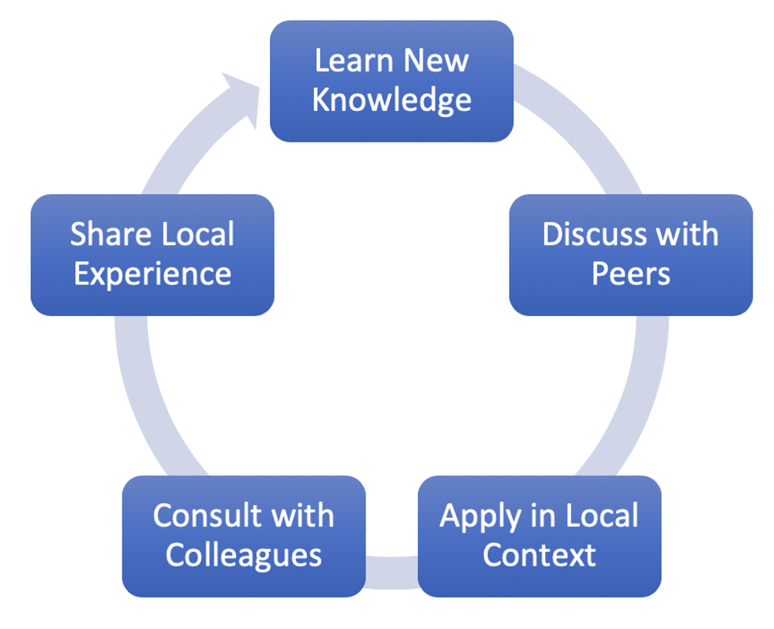
“Communities of Practice”
Lave and Wenger 1988

Slide 5
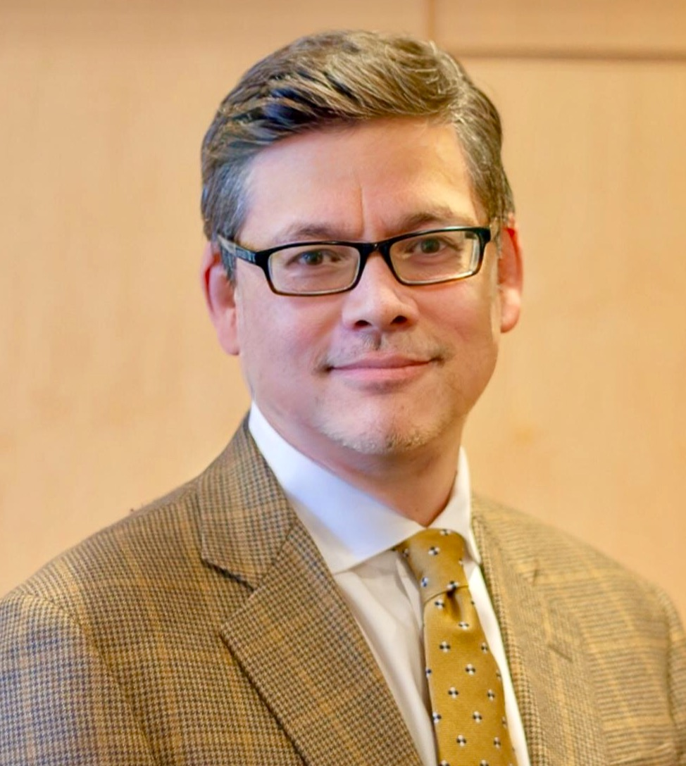
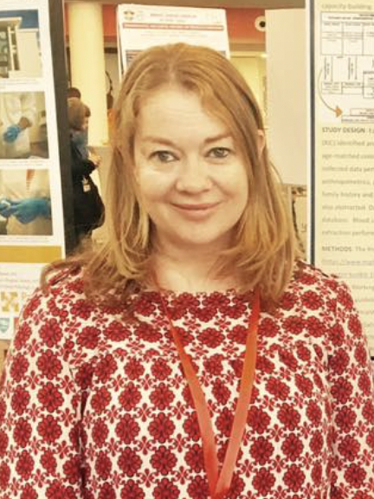
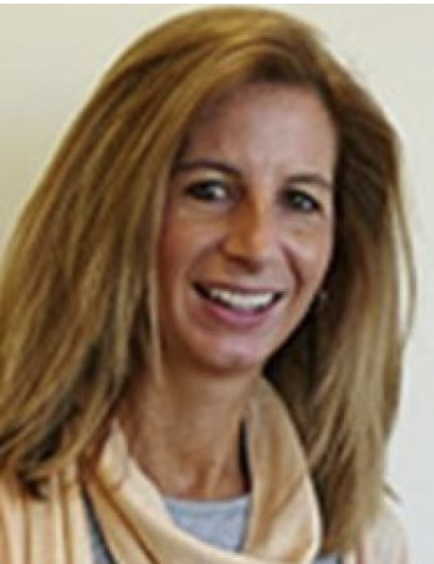
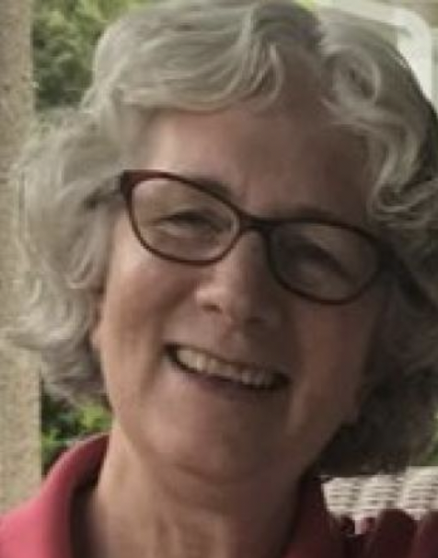
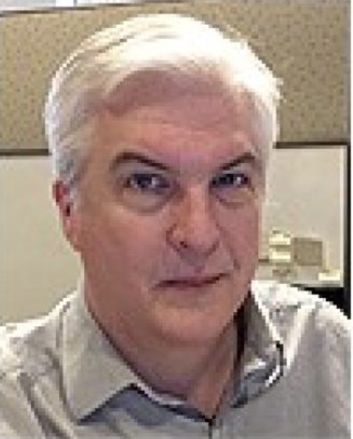
Leadership
Dr. Timothy Rebbeck
DFCI, Boston
Dr. Yuri Quintana BIDMC, Boston
Dr. Elima Jedy-Agba
Abuja, Nigeria and London UK
Dr. Mohamed Jalloh
Hôpital Général Idrissa Pouye, Dakar, Senegal.
Emeka Odiaka
Consultant
Caroline Andrews
DFCI, Boston
Deb Cote
DFCI, Boston
Janet Dougherty
DFCI, Boston
David Pesta
DFCI, Boston

Slide 6
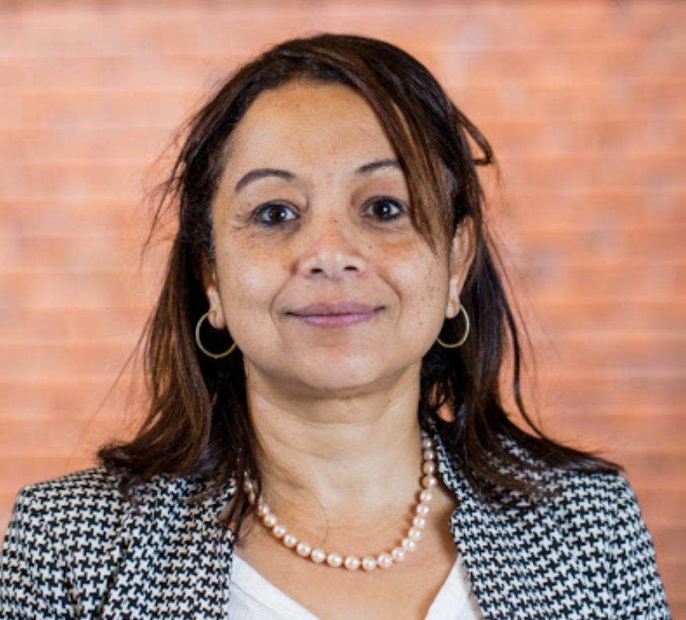
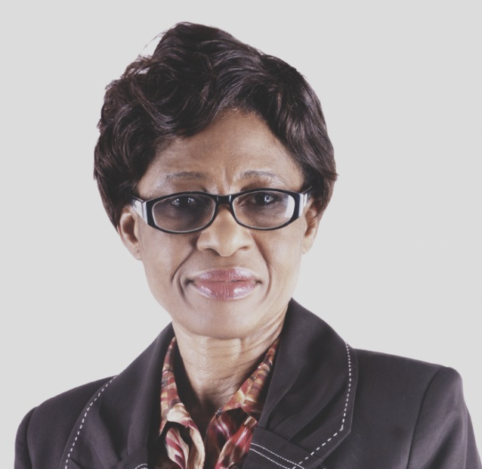
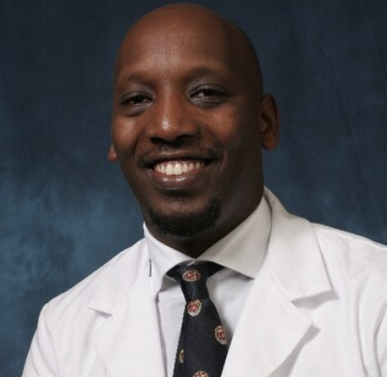
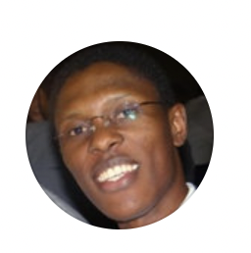
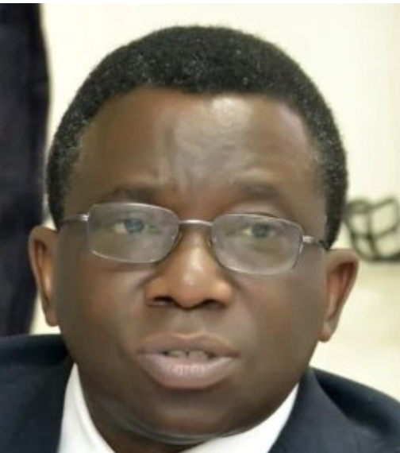
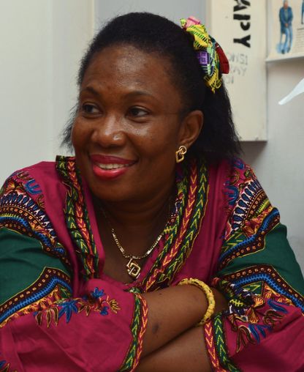
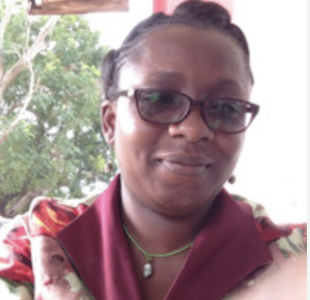
Advisory Board
Shaheen Sayed | Nairobi, Kenya
Chioma Asuzu | Ibadan, Nigeria
Christian Ntizimira | Kigali, Rwanda
Michael Mwachiro | Bomet, Kenya
Isaac Adewole | Ibadan, Nigeria
Verna Vanderpuye | Accra, Ghana
Hannah Ayettey Anie | Accra, Ghana

Slide 7
Training
Common Core Curriculum: PROMOTE
Principal Investigator (PI-STARS) Track: for doctoral-level investigators who will be trained to demonstrate leadership in independent and collaborative research, and
Project Manager (PM-STARS) Track: for those interested in gaining skills in project management to be able to support the conduct of research.

Slide 8
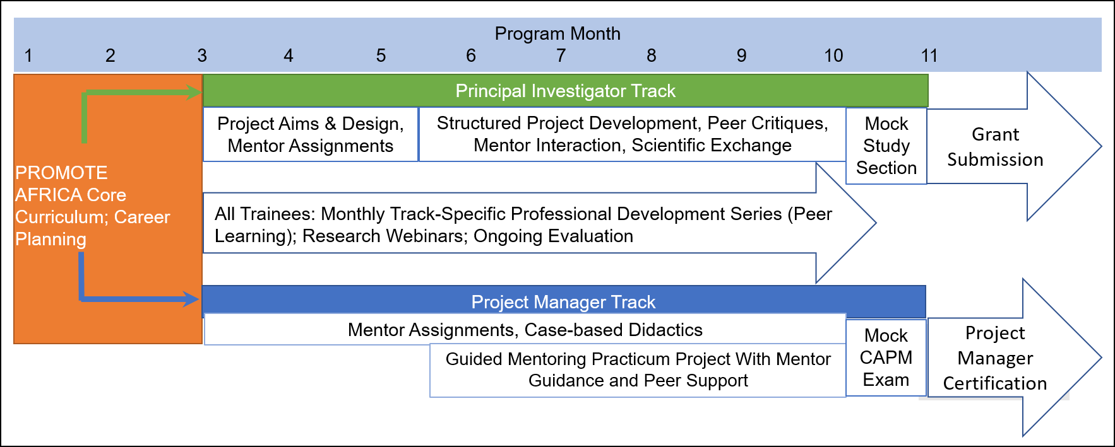
Hybrid Cancer Research Training Model
PI
PM

Slide 9
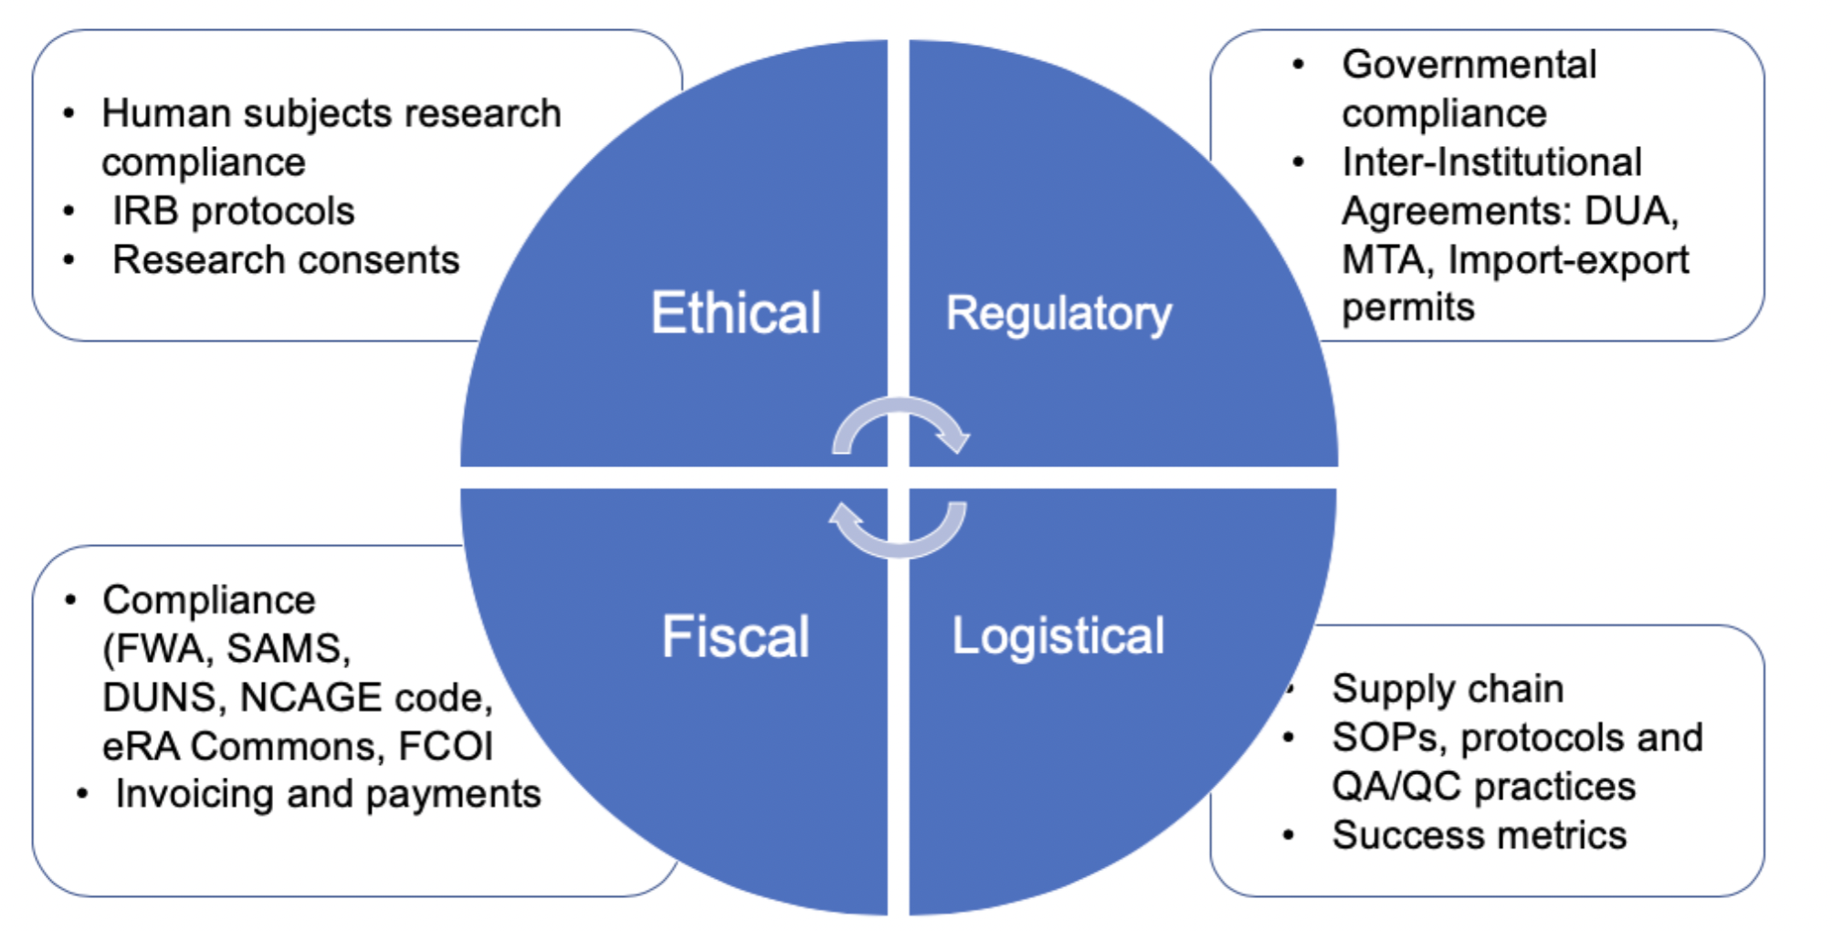
PROMOTE Curriculum

Slide 10
PI Track: Mentors and Collaborators
Didactic Lectures and Discussions
Coordination with sponsor, mentors, collaborators, trainee, and program directors about research project development
Technical and scientific exchanges to develop your project

Slide 11
PI Track: Project Development
Use the STARS lectures to develop and refine research project as a learning tool and for submission:
What Is Research? Forming Important Research Questions
Grant Resources & Grant Calls
Understanding What The Grant Reviewer Is Looking For
Writing Effective Specific Aims
Defining The Importance Of The Question: Significance And Innovation Sections
Study Design & Recruiting
Research Methodology And Interpretation
Results Interpretation
Research Data Management Plan
Finalizing & Editing Research Proposal

Slide 12
PI Track: Mock Study Section and Grant Submission
Using an NIH template, prepare a grant as if it were being submitted to the funding agency
Submit to trainees, who will review the grant as if it was being reviewed by an actual study section.
Use this feedback to refine proposal for submission

Slide 13
PM Track: Certification
Months 4-6 follow the training requirements to attain Dana-Farber Cancer Institute’s Cancer Research Project Management in sub-Saharan Africa certification
Project Management overview, understand process groups, project life cycle, agile methodologies, business analysis, knowledge areas
Project Charter and survey design
Scope and stakeholder planning and management
Resource and risk planning and management
Communications, schedule, and cost & procurement planning and management
Redcap database management, Process mapping, and Microsoft Project demo
Lessons learned, project ethics and professionalism, team dynamics, influencing without authority, and delegation
Change and quality management, evaluating and delivering project benefits and value
Leading strategic change and responding to change
Presenting and public speaking

Slide 14
PM Track: Certification and Projects
Months 7-8 attend lectures, discussion, and exam preparation to be equipped to take Project Management Institution’s Certified Associate in Project Management exam
There will be focused lectures on Agile and Business Analysis, exam prep mentored sessions and trainees will take a Mock CAPM Exam
Trainees interested in taking this exam should register to take the exam in January 2025
Trainees will be registered for a year with Project Management Institute (with access to the PMBOK7, Business Analysis, and Agile handbooks, and other materials), and registered to take the exam by D43 STARS.
Months 9: Project development and presentations
Project development working closely with mentors
Project presentations by trainees

Slide 15
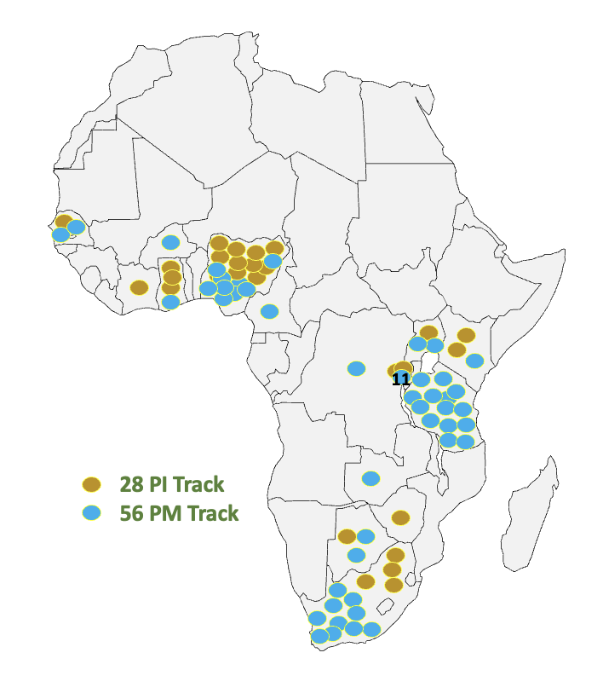
STARS Trainees
By The Numbers:
Three Cohorts
84 trainees
46 men, 38 women
15 countries

Slide 16
Trainee accomplishments and Milestones
Notes:
The D43 allows US institutions to support training and research experiences that will develop or expand an ongoing collaboration with an LMIC institution. In addition to training support to conduct research, we anticipate the awards will also facilitate research mentorship in US and LMIC institutions and provide long term funding to allow the development of multi-disciplinary training programs.

Slide 17
Timeline
October 3, 2022 Program Announcement
December 30, 2022 LOI Due
February 6, 2022 Applications Due
March 2023 Scientific Merit Review
April 3, 2023 Decisions Announced
May 15, 2023 Training Start Date
Inquires: contact@africancancerstars.org
Web: www.africancancerstars.org

Slide 18
Bidirectional Training to Enhance Cancer Research Capacity in Africa
Supported by D43-CA260640
www.Africancancerstars.org
Next Application deadline: December 2024

