Slide 1
Bidirectional Training to Enhance Cancer Research Capacity in Africa
Supported by D43-CA260640

Slide 2
Motivation
The growing burden of cancer in Sub-Saharan Africa (SSA) must be addressed by African cancer researchers.
Cancer Researchers in SSA often lack
Mentorship
Collaborators
Grant writing expertise
Project management
Best practices for research rigor

Slide 3
Principles
Bilateral Interactions: Mentorship can involve input from both SSA and non-SSA experts
Africa-Centric Protocols and Practices: Cancer research in SSA can be based on those developed in the US and elsewhere, but these must be adapted to the SSA setting to address African needs and questions.
Results generated by cancer researchers in SSA should have:
Global scientific impact
Local health impact

Slide 4
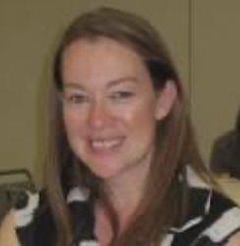
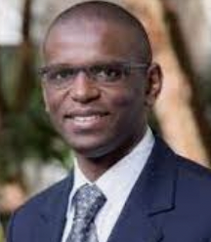
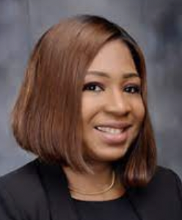
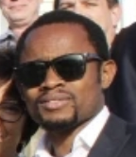
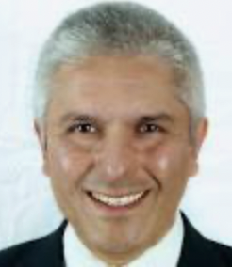
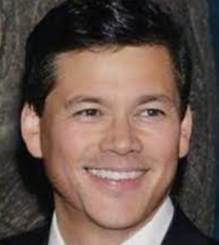
Leadership Team
Caroline Andrews (Boston)
Mohamed Jalloh (Dakar)
Elima Jedy-Agba (Abuja)
Emeka Odiaka (Gold Coast)
Yuri Quintana (Boston)
Tim Rebbeck (Boston) - PI
Project Management Institute

Slide 5
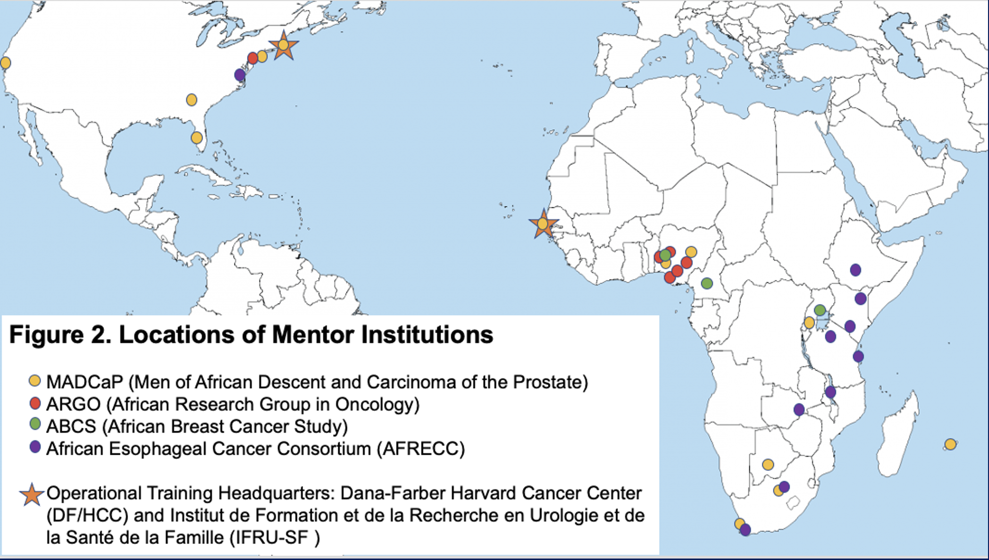
Key Partners & Vetted Training Institutions
Project Management Institute
African Oncogenetics Network (AON)
African Hepatopancreatobiliary Cancer Consortium

Slide 6
Training Tracks
A Principal Investigator (PI-STARS) Track: for doctoral-level investigators who will be trained to demonstrate leadership in independent and collaborative research, and
A Project Manager (PM-STARS) Track: for those interested in gaining skills in project management to be able to support the conduct of research.

Slide 7
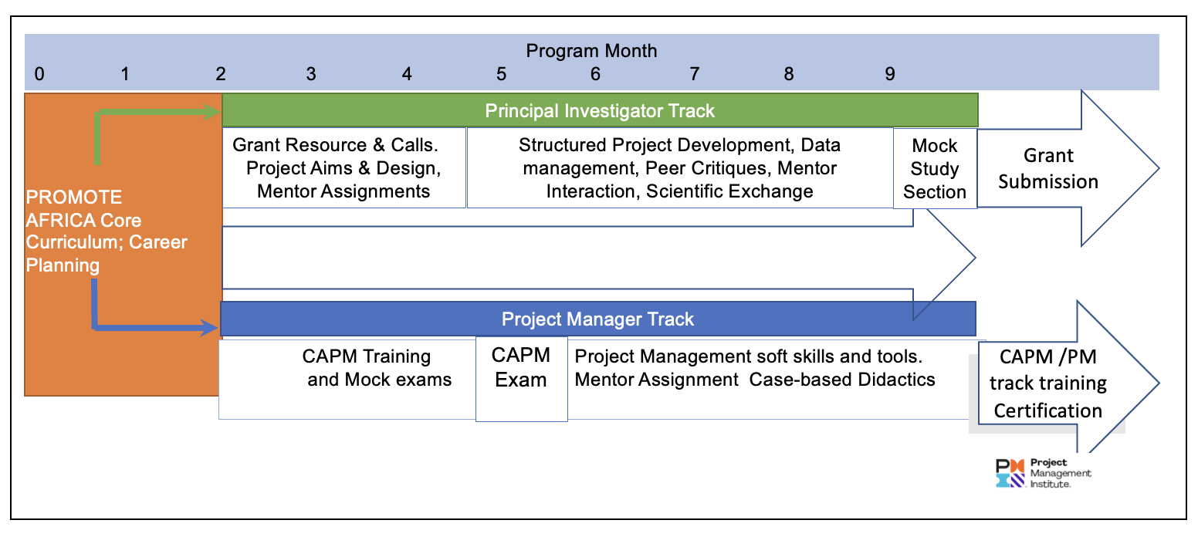
Hybrid Cancer Research Training Model
PI
PM

Slide 8
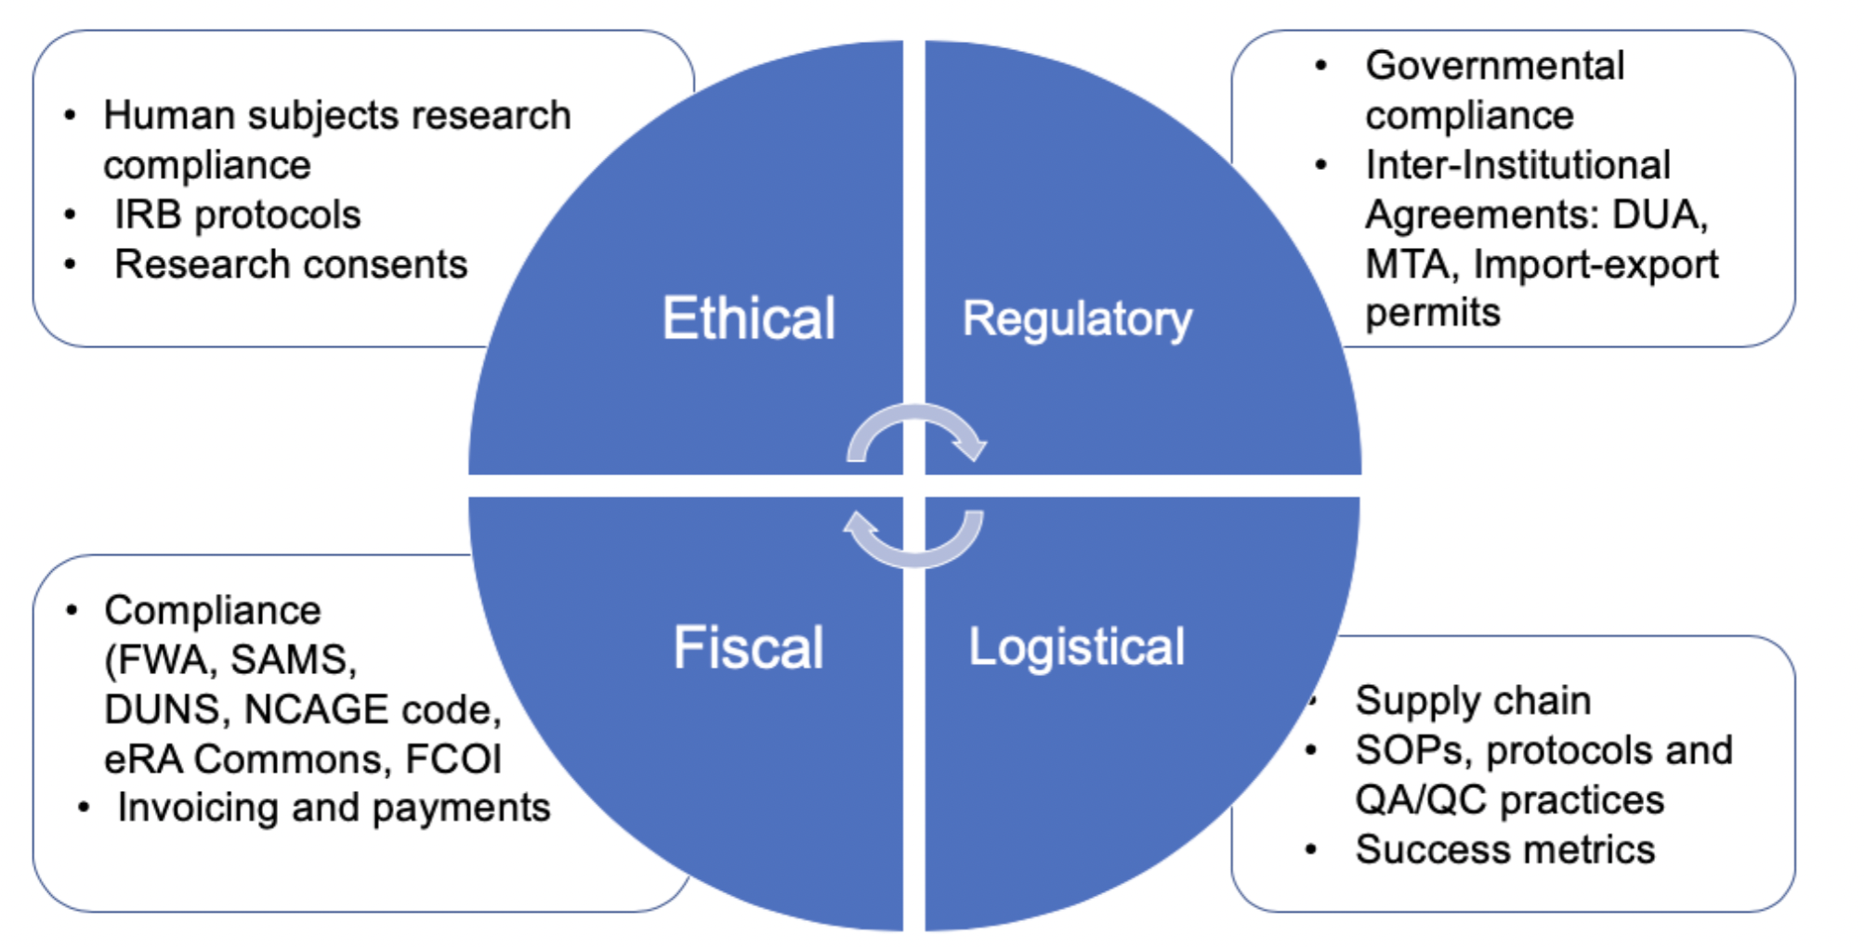
PROMOTE Curriculum

Slide 9
Candidates
Institutional Environment & Commitment
Readiness
Mentorship
Successful Candidate

Slide 10
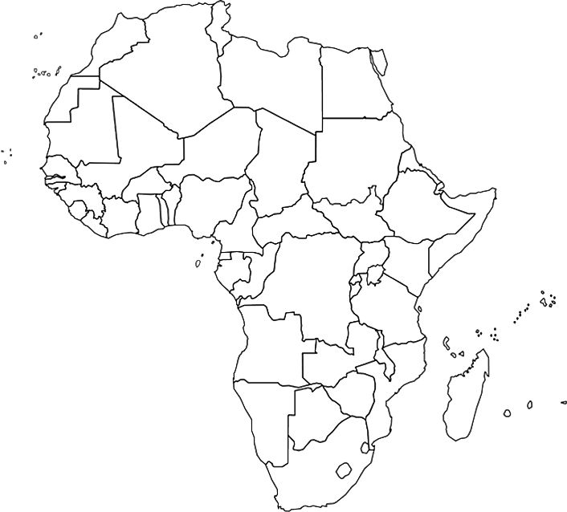
Class of 2022
Trainee Themes
Biomarkers | Mitochondrial
 | Diagnostic
 | Early Detection
 | Prognostic
Biobanking
Bioethics
Breast Cancer
Epidemiology
Immunology
Liver Cancer
Molecular Biology
Pharmacology
Prostate Cancer
Surgical Oncology
PI (N=8)
PM (N=15)
Success Metrics:
Career advancement
PI: Grant funding
PM: Project management certification

Slide 11
Timeline
October 3, 2022 Program Announcement
December 30, 2022 LOI Due
February 6, 2022 Applications Due
March 2023 Scientific Merit Review
April 3, 2023 Decisions Announced
May 15, 2023 Training Start Date
Inquires: contact@africancancerstars.org
Web: www.africancancerstars.org

