Slide 1
Federal Grant Award Preparation and Implementation: A Project Manager Perspective
D43CA260640
Angelina Fink, MPH, CCRP – Moffitt Cancer Center
Bidirectional training to enhance cancer research capacity in Africa-D43CA260640

Slide 2
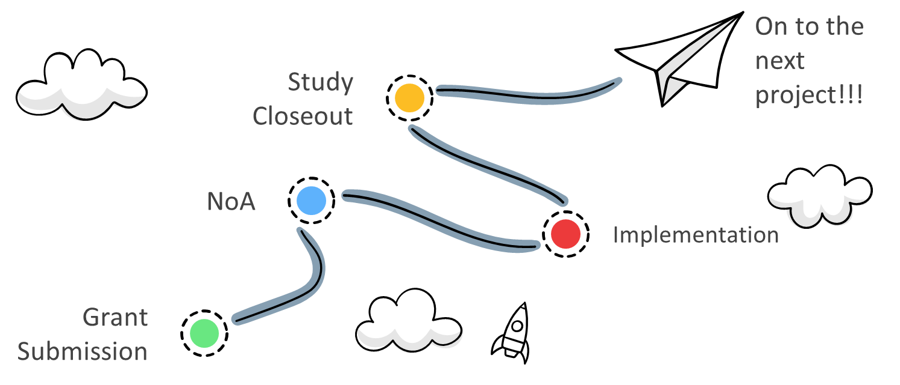
Federal Grants: Concept to Completion

Slide 3
Principal Investigator
Contracts
Research Finance
Important relationships throughout the project lifecycle
Project Manager
Grants Admin
Regulatory
Participating Sites

Slide 4
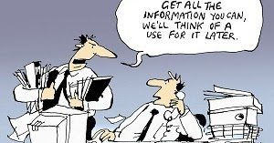
Start planning and gathering information as soon as you know a grant is planned
Notify, grants administrators, research finance personnel, contracts, regulatory
Institution contacts
Work with your grants administrator or research support to determine required information and timelines/deadlines
Communicate deadlines to all participating sites as soon as possible
Grant Submission

Slide 5
Funded Projects
Notice of grant award has been received
Immediately start working with all the necessary people/teams to get your project timelines and obtain required information necessary for receipt and distribution of funding
Finance
Regulatory
Contracts
This is the most crucial time for a Project Manager

Slide 6
After Implementation
Invoicing
FTE (effort), supplies, etc.
Progress Reporting
Study Closeout

Slide 7
Tips, Takeaways & Lessons Learned
Build a robust support system
Start planning early
Don’t assume things will go smoothly
Triple check all information
Get to know your partner institutions
There is no “one-size-fits-all” approach

Slide 8
Thank You!

